Slide 1

HOME
DOCTOR
Founder M Qavi Shaikh

Slide 2
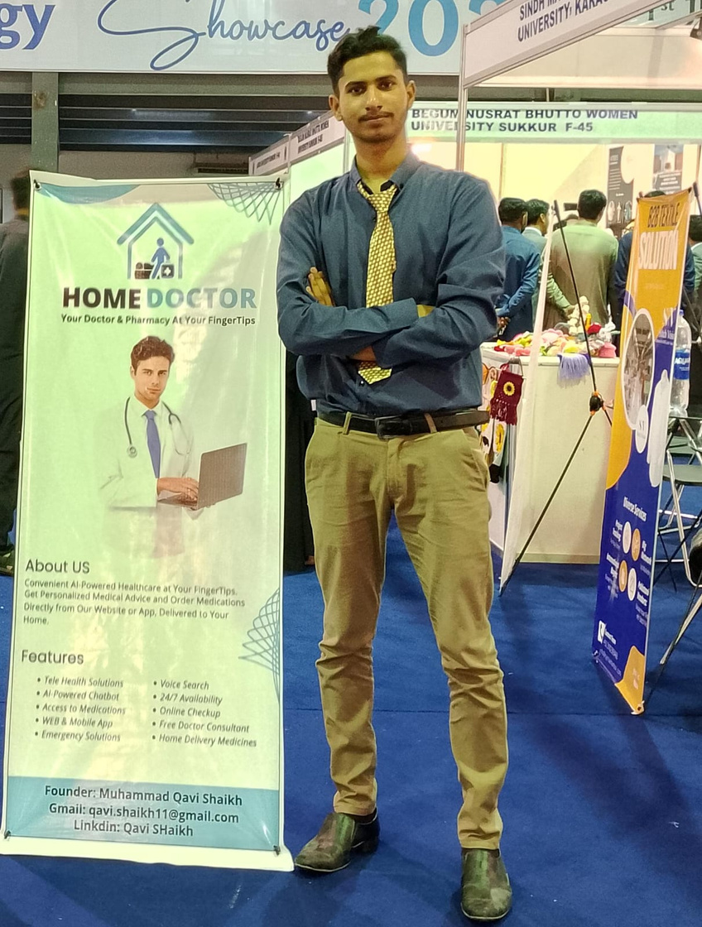
ABOUT FOUNDER
IT Student
Experienced Developer
MERN Stack Developer
Medical Experienced as a Dispenser
1 Year Teaching Experinced in Tech
Last Startup: Digital Web Creations
Positions Holder & Different Certifications
Freelancer

Slide 3
STARTUP STORY
One day at a medical store near a hospital, I noticed a group of women desperately seeking relief for severe headaches and high fevers. The pharmacist provided over-the-counter medication for temporary comfort until they could see a doctor. The next day, I saw a similar scene with different people in the same rush. This recurring urgency inspired me to create an app that would allow people to order medication from home and receive guidance for common ailments like headaches and fevers. This idea aimed to revolutionize healthcare access, making it easier and more convenient for individuals to get the help they needed with just a few taps on their phones.

Slide 4
PROBLEM STATEMENT
1
2
Low Health Literacy and Limited Medical Knowledge
Inconvenience and Inefficiency in Accessing Medication
Many individuals, particularly the less educated, lack the understanding of medical concepts and treatments, preventing them from making informed healthcare decisions.
Current healthcare systems make it difficult for people to obtain timely relief for common ailments like headaches and fevers, especially when immediate consultation with a doctor is not possible

Slide 5
SOLUTION
AI-Powered Symptom Analysis and Treatment Recommendations
Our web and mobile applications feature an AI chatbot that uses natural language processing to accurately understand users' symptoms and medical conditions, providing personalized treatment recommendations and appropriate medication options.
Convenient Medication Ordering and Delivery
Users can order recommended medication directly through our platform, eliminating the need for multiple pharmacy visits and ensuring quick, home-based access to necessary treatments.

Slide 6
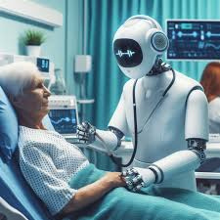
FEATURES
Tele Health Solutions
AI-Powered Chatbot
Access to Medications
WEB & Mobile App
Voice Search
24/7 Availability
Online Checkup
Free Doctor Consultant
Home Delivery Medications

Slide 7
BACKUP PLAN
Problem
Solution
Medical stores often face significant rush, causing inconvenience for customers and delays in obtaining necessary medications. This results in crowded stores and longer wait times, especially for those with urgent needs.
We propose an online medicine booking system that allows customers to book their required medications in advance, reducing in-store congestion and ensuring quick access to medications
Online Booking Platform: Each medical store will have access to a computer-based system where clients can book their medications online. Customers will use a web or mobile application to select and reserve the medications they need.
Streamlined Pickup Process: Once the order is placed, the medical store will prepare the medications in advance. Customers can then pick up their pre-packaged medications without waiting in line, ensuring a smooth and efficient process.

Slide 8
CLIENTS
Primary Clients
Partner with pharmaceutical companies as our main clients. This will integrate their products into our system, ensuring a steady revenue stream.
Initial Free Run:
Launch our services for free initially to build a user base and showcase the platform’s effectiveness.
Free Physical Camps:
Organize free physical health camps to promote our online system. These camps will provide checkups, demonstrate the platform’s use, build trust, and raise awareness among users.
Guidance and Awareness:
During the camps, guide users on how to use our online system, ensuring they understand its benefits and functionality.

Slide 9



1ST STARTUP
DIGITAL WEB CREATIONS
Funded By GC University (ORIC Department)
PKR 50,000
PKR 14,000
Investment
Profitt in 3 Months

Slide 10


2ND STARTUP
Present at HEC EXPO Karachi
HOME DOCTOR
Select as a Final Year Project
Founder M Qavi Shaikh
PKR 30,000
5
200
Expected Revenue
Clients
Users
Half Quarter Expected Model

Slide 11




CONTACT US
0313-3825456
Qavi Shaikh
qavi.shaikh11@gmail.com
Presenter Qavi Shaikh

